Slide 1
The History of Genetics
Chapter 3-1

Slide 2
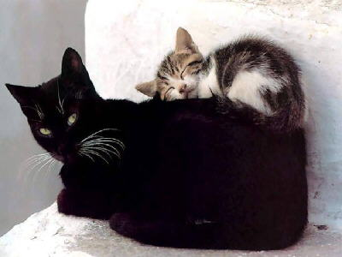

Slide 3
Who is Gregor Mendel?
Austrian monk/priest
Lived in the 1800’s
Taught math and science at the monastery
Loved to garden; studied traits of pea plants
Father of Genetics

Slide 4
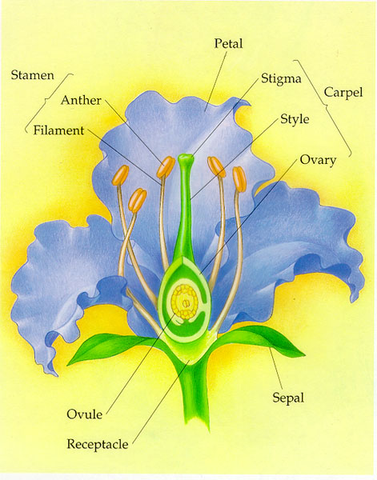
How Do Plants Reproduce?
By the process called pollination
Pollen from the male stamen fertilizes the egg of the female pistil to create a seed.
Two types: Self pollination and Cross pollination

Slide 5
Mendel’s Pea Plant Experiments
Step 1: Self pollinated purebred tall pea plants and purebred short pea plants
Created the parent generation (P generation)
One purebred tall parent and one purebred short parent
Step 2: Cross-pollinated purebred tall pea plants with short pea plants
Created the F₁ generation
All of the offspring were tall
Step 3: Self pollinated the F₁ generation
Created the F₂ generation
¾ of the offspring were tall; ¼ were short
Step 4: Repeated experiment with different pea plant traits
Results were the same

Slide 6
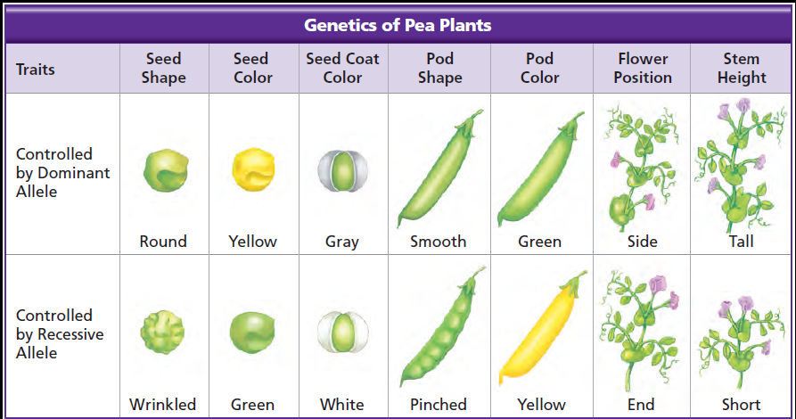

Slide 7
What did Mendel Learn?
Traits are determined by individual separate alleles inherited by each parent
Alleles come in pairs; one from each parent
Traits are either dominant or recessive; dominant traits can mask recessive traits

Slide 8
Heterozygous: genotype: homozygous: phenotype:
Mendel’s experiments
P generation
F₁
F₂

